Slide 1


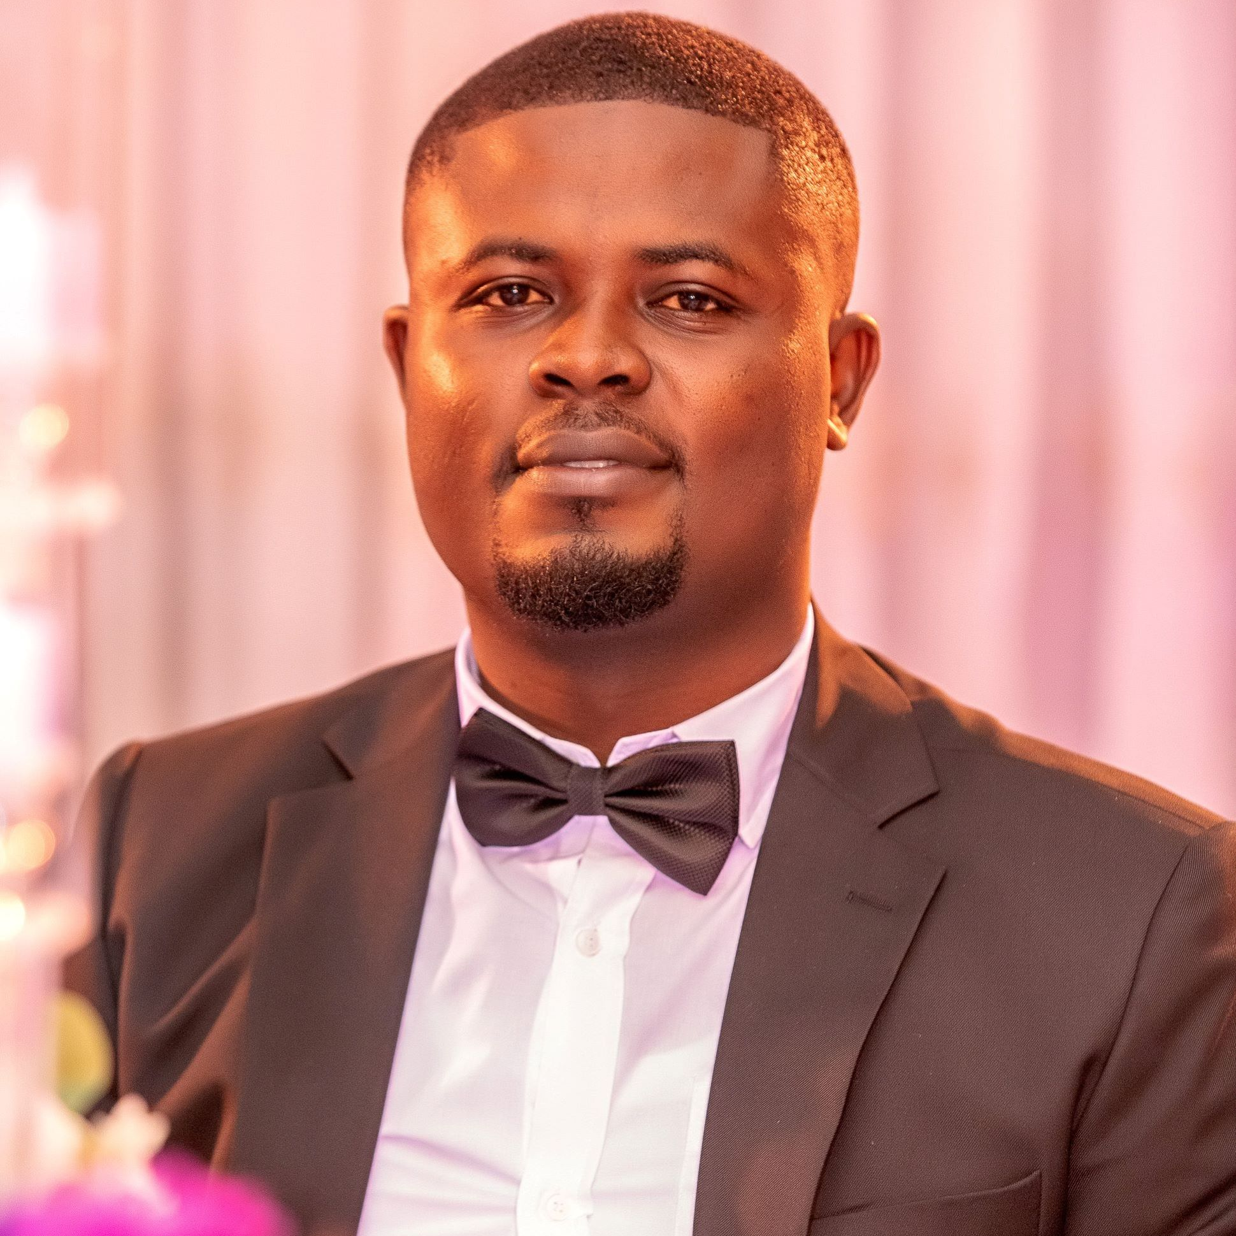
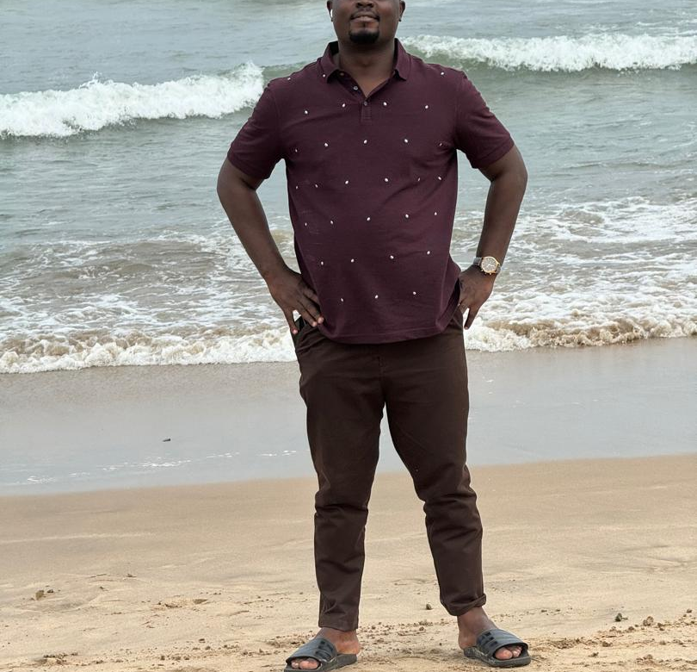
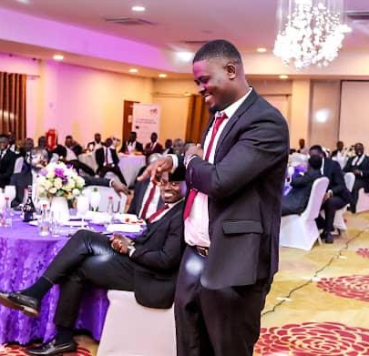
Getting to Know Me
Work
Personal
My role
Corporate Accountant
Significant others / family members / furry friends in my life
My wife and the 3-kids
Tenure in ofi/Olam
9-yrs
How I enjoy spending my free time
Watching football matches
Previous companies I have worked at
Accountant- CAGD
Primal Point Poultry Farm
My favorite / comfort food
Fufu and light soup, and sometimes Yam and Palava sauce
Why I joined ofi/Olam and what keeps me here?
I joined ofi/Olam because I was inspired by its strong global presence, commitment to employees, and the opportunity to work in a dynamic, fast-paced environment that align with my professional goals
And what keeps me here is the opportunity to continously learn and grow. Ofi provides a platform for innovations, and I appreciate how much ownership and accountability are given at all levels.
My favorite song
Culture- Trust me
Collins Appiah
‘Collay’
A few fun facts about me
I’m a huge fan of football, and I like laughing and joking
This is me outside work, doing stuff I enjoy in my life …

